Slide 1
Slaviša Đurđić
Tableau Superstore Sample Dataset
Goal: Analysis of the Tableau “Superstore” sample dataset and the “Employee” sample table and build visuals in Power BI, as per below instructions.
Instructions:
SCENARIO 1 :
• Create a column chart with age group and sum of salary and sort column chart by age group in ascending order.
SCENARIO 2:
• Find Year to Date sales – Create a KPI chart that only shows YTD sales and prove the result by creating table next to it.
SCENARIO 3:
• Create a monthly trend chart for sales where the sequence of months in the chart should be as per the US financial year (Starts on Oct.1 and ends on Sep.30).
SCENARIO 4:
• Create a grid view with year of order date, category, sales, profit and quantity.
• Add a dynamic title to the view so that whenever a slicer is operated the title should show the filter value whichever user selects.
SCENARIO 5:
• Create a bar chart using subcategory and sum of sales.
• Add a GREEN color to the subcategory bars if sum of sales are greater than 150,000 and RED color if sum of sales are less than 150,000.
Belgrade, March 2024

Slide 2

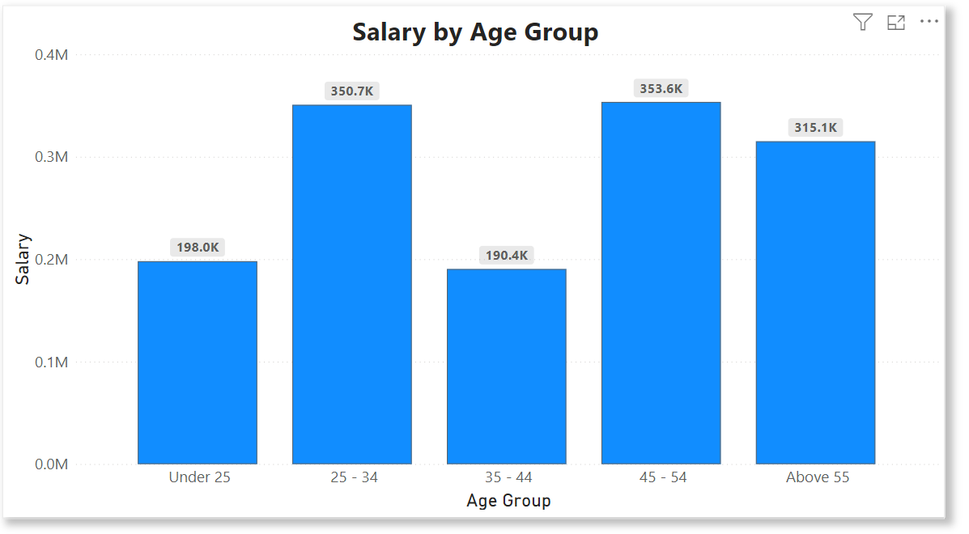
Microsoft Power BI

Slide 3
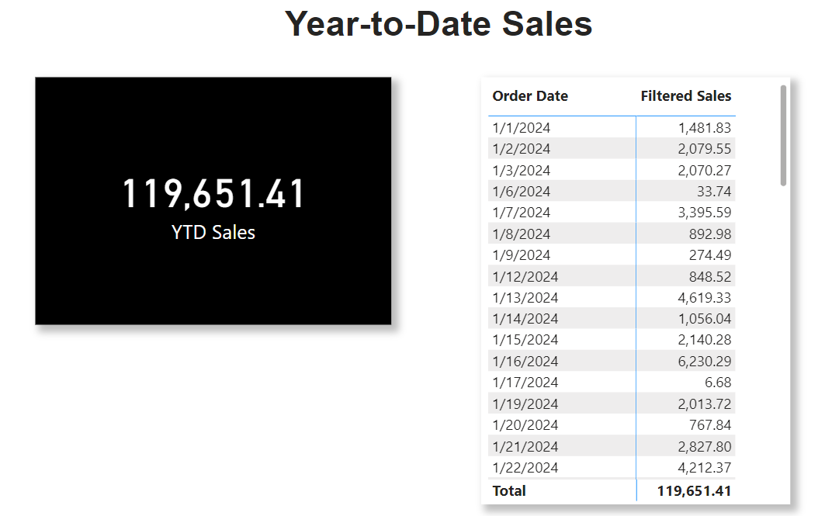
Microsoft Power BI

Slide 4
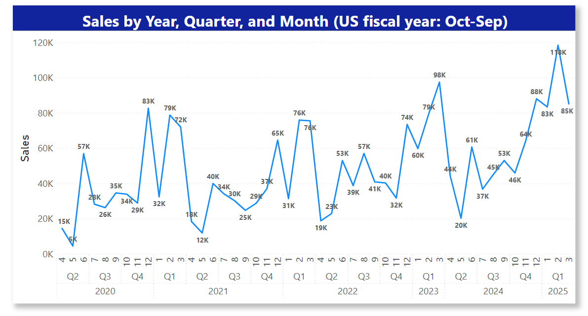
Microsoft Power BI

Slide 5
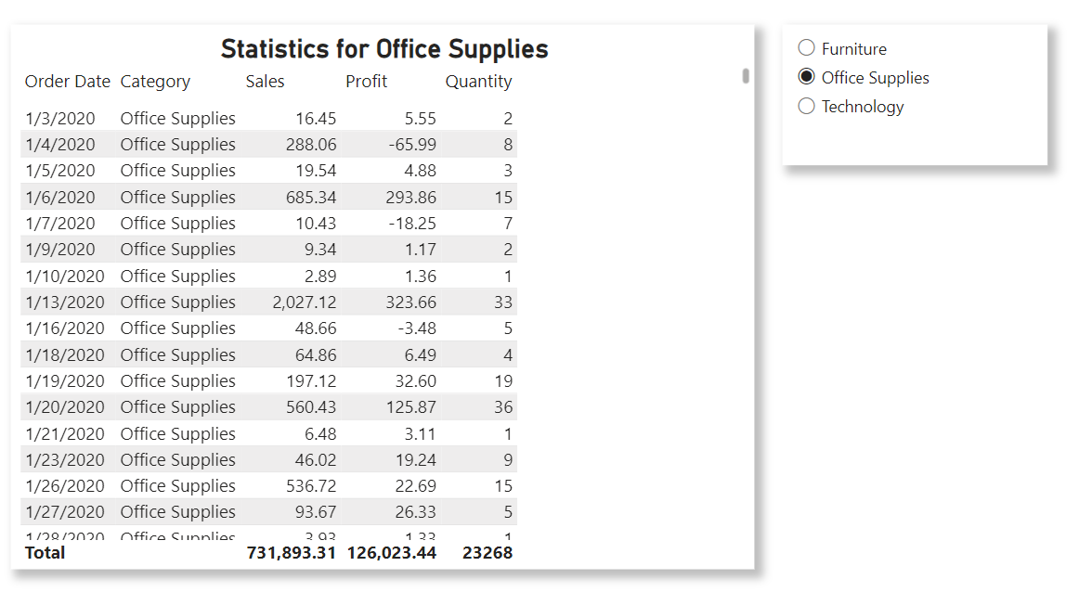
Microsoft Power BI

Slide 6
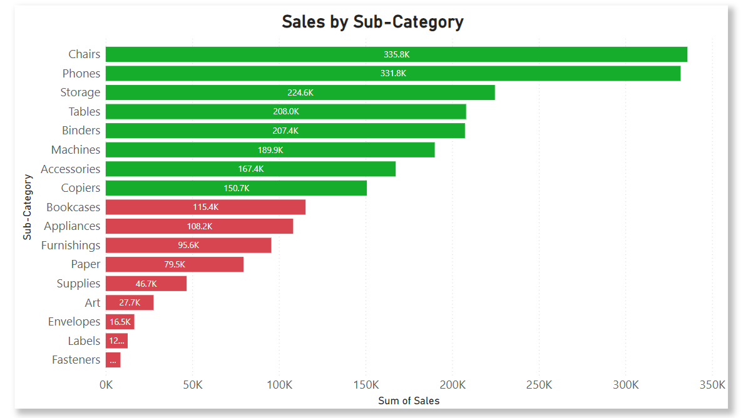
Microsoft Power BI

